Slide 1

ADAMAS UNIVERSITY DATA REPOSITORY SYSTEM
PRESENTER
SRABON KUMAR GHOSH
ROLL-84
RIDDHI ACHARYA
ROLL-67
Dr. SAJAL SAHA
RAVI SHARMA
HOD
ROLL-64
GUIDE NAME
AMITRAJIT CHATTOPADHYAY
ROLL-16

Slide 2









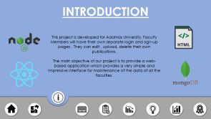
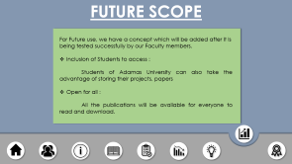
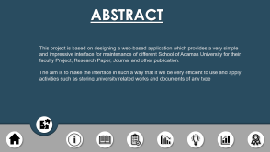
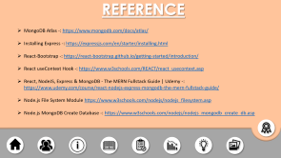
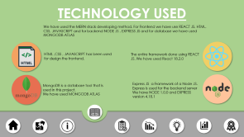
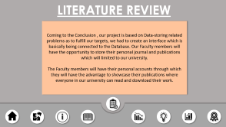
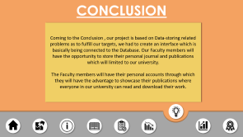
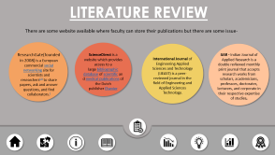
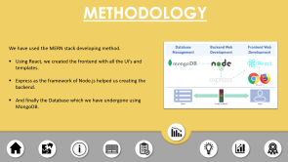
CONTENT

Slide 3
ABSTRACT
This project is based on designing a web-based application which provides a very simple and impressive interface for maintenance of different School of Adamas University for their faculty Project, Research Paper, Journal and other publication.
The aim is to make the interface in such a way that it will be very efficient to use and apply activities such as storing university related works and documents of any type

Slide 4
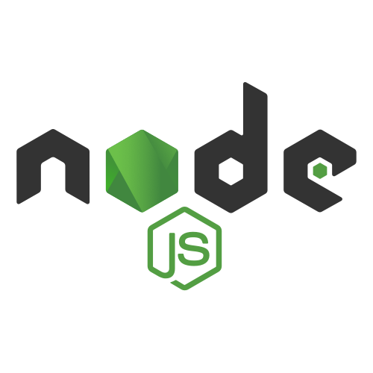
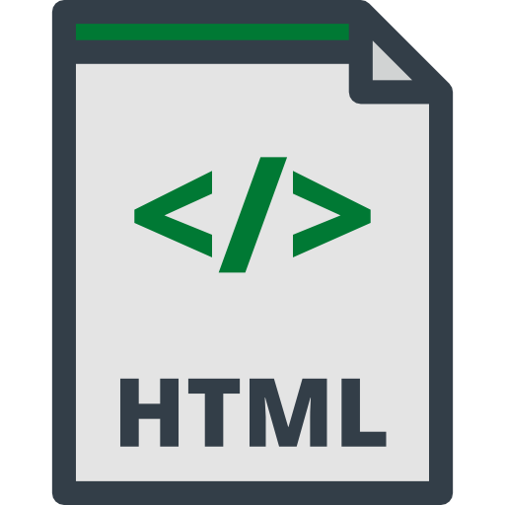


INTRODUCTION
This project is developed for Adamas University. Faculty Members will have their own separate login and sign-up pages . They can edit , upload, delete their own publications.
The main objective of our project is to provide a web-based application which provides a very simple and impressive interface for maintenance of the data of all the faculties.

Slide 5
TECHNOLOGY USED
We have used the MERN stack developing method. For Frontend we have use REACT JS, HTML, CSS, JAVASCRIPT and for backend NODE JS , EXPRESS JS and for database we have used MONGODB ATLAS
HTML ,CSS , JAVASCRIPT has been used for design the frontend.
The entire framework done using REACT JS. We have used React 18.2.0
MongoDB is a database tool that is used in this project.
We have used MONGODB ATLAS
Express JS a Framework of a Node JS.
Express is used for the backend server
We have NODE 1.0.0 and EXPRESS version 4.18.1

Slide 6
LITERATURE REVIEW
There are some website available where faculty can store their publications but there are some issue-
ResearchGate(founded in 2008) is a European commercial social networking site for scientists and researchers^{[2]} to share papers, ask and answer questions, and find collaborators.[
ScienceDirect is a website which provides access to a large bibliographic database of scientific and medical publications of the Dutch publisher Elsevier
IJAR - Indian Journal of Applied Research is a double reviewed monthly print journal that accepts research works from scholars, academicians, professors, doctorates, lecturers, and corporate in their respective expertise of studies,
International Journal of Engineering Applied Sciences and Technology (IJEAST) is a peer-reviewed journal in the field of Engineering and Applied Sciences Technology.
.

Slide 7
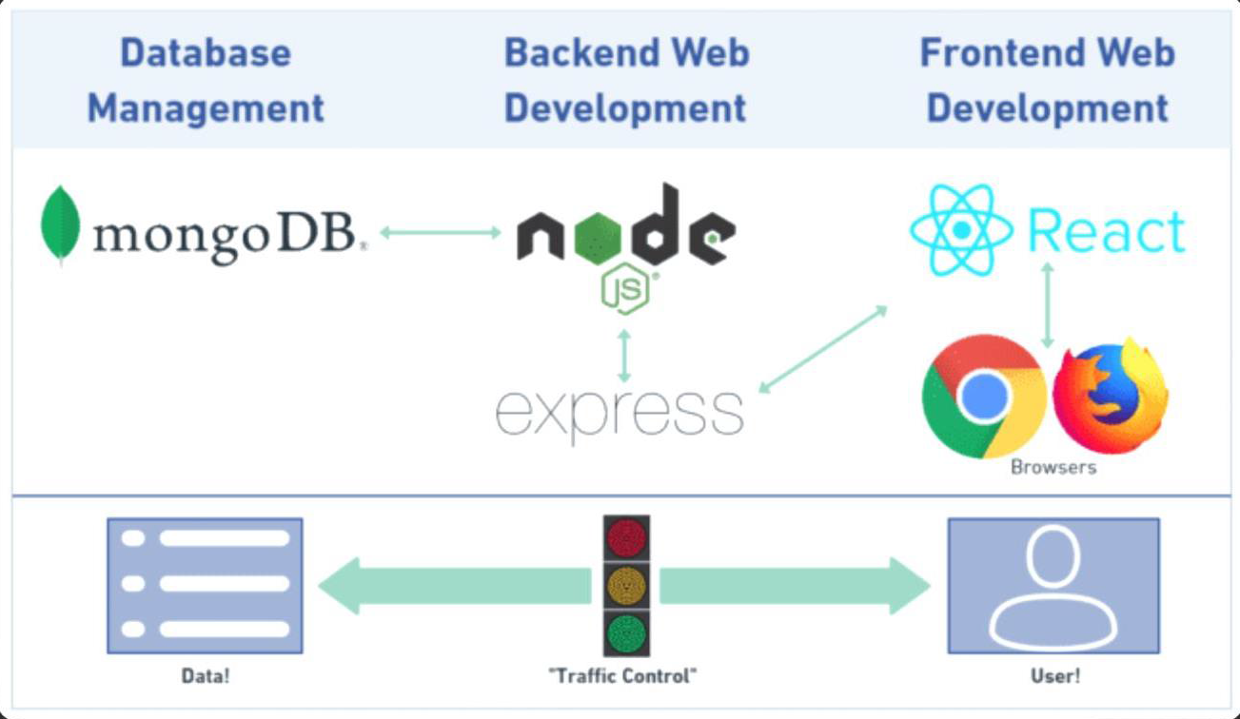
METHODOLOGY
We have used the MERN stack developing method.
Using React, we created the frontend with all the Ui’s and templates.
Express as the framework of Node.js helped us creating the backend.
And finally the Database which we have undergone using MongoDB.

Slide 8
CONCLUSION
Coming to the Conclusion , our project is based on Data-storing related problems as to fulfill our targets, we had to create an interface which is basically being connected to the Database. Our Faculty members will have the opportunity to store their personal journal and publications which will limited to our university.
The Faculty members will have their personal accounts through which they will have the advantage to showcase their publications where everyone in our university can read and download their work.

Slide 9

FUTURE SCOPE
For Future use, we have a concept which will be added after it is being tested successfully by our Faculty members.
Inclusion of Students to access :
Students of Adamas University can also take the advantage of storing their projects, papers
Open for all :
All the publications will be available for everyone to read and download.

Slide 10

REFERENCE
MongoDB Atlas -: https://www.mongodb.com/docs/atlas/
Installing Express -: https://expressjs.com/en/starter/installing.html
React-Bootstrap -: https://react-bootstrap.github.io/getting-started/introduction/
React useContext Hook -: https://www.w3schools.com/REACT/react_usecontext.asp
React, NodeJS, Express & MongoDB - The MERN Fullstack Guide | Udemy -: https://www.udemy.com/course/react-nodejs-express-mongodb-the-mern-fullstack-guide/
Node.js File System Module https://www.w3schools.com/nodejs/nodejs_filesystem.asp
Node.js MongoDB Create Database -: https://www.w3schools.com/nodejs/nodejs_mongodb_create_db.asp

Slide 11

THANK YOU

